Slide 1
A SQN Method
for Non-convex Optimization with Non-uniform Smoothnes
SEYYEDREZA MOSLEMI
MOSTAFA KOOTI
NIMA MIRI

Slide 2


A SQN Method
for Non-convex Optimization with Non-uniform Smoothnes
SEYYEDREZA MOSLEMI
810103326

Slide 4


Main Objective
Stochastic Optimization Problem
O
O
Empirical risk minimization (ERM)
Minimize the expected loss :function
$$\min_{x}{F\left(x\right)≔E_{ξ∼P}\left[l\left(x;ξ\right)\right]}$$
Model parameter :$x∈R^{d}$
Random variable from unknown :$ξ$
distribution P
$l\left(x;ξ\right)\text{ :}\text{Loss} \text{function}$
Sample-based approximation of expectation:
$$\min_{x}{\frac{1}{n}\sum_{i=1}^{n}{l\left(x;ξ_{i}\right)}}$$
Advanced Optimization
4

Slide 5
Challenges and solutions
1
Challenges in Modern ML:
Non-convexity in deep learning and machine learning
Hard to solve analytically
2
Stochastic Approximation (SA) & SGD
SA for solving optimization problems
SGD as a classical SA method
Replaces full gradient with stochastic samples
Simple and effective
3
Limitations
fail to capture curvature of the objective function
Better performance expected from second-order methods
Advanced Optimization
5

Slide 6
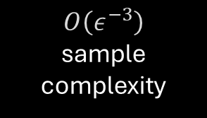
Quasi-Newton Methods
Use first-order info to approximate Hessian
Efficiency, robustness, and accuracy
VR techniques improve sample efficiency
1
3
5
2
4
Integrate with stochastic gradient methods
$$O\left(ε^{−3}\right)$$
sample complexity
Advanced Optimization
6

Slide 7
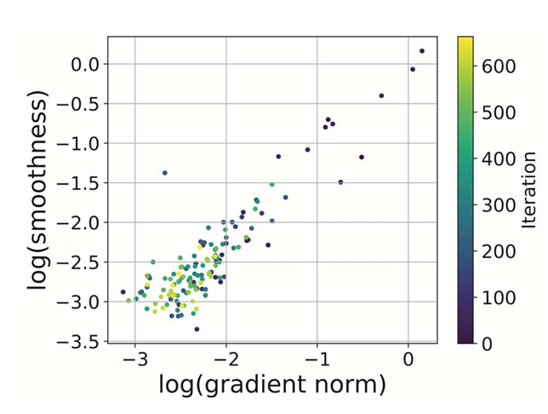

Non-Uniform Smoothness
uniform smoothness:
Gradient ∇F(x)is L-Lipschitz continuous
Non-uniform smoothness
Lipschitz constant grows along the training trajectory
Introduced: $\left(L_{0},L_{1}\right):$
Smoothness increases linearly with gradient norm:
$$\left|\left|∇^{2}F\left(x\right)\right|\right|≤L_{0}+L_{1}\left|\left|∇F\left(x\right)\right|\right|$$
RL problems exhibit $\left(L_{0},L_{1}\right)$-smoothness
Gradient clipping to control growing gradients
Advanced Optimization
7

Slide 8
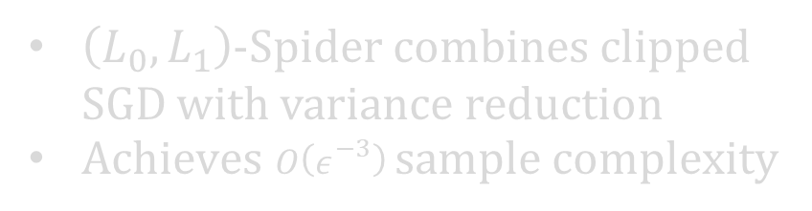

Clipped SGD and Sample Complexity
can find an $ε$-approximate solution
$O\left(ε^{−4}\right)$ sample complexity
$\left(L_{0},L_{1}\right)$-Spider combines clipped SGD with variance reduction
$Achieves O\left(ε^{−3}\right) sample complexity$
Advanced Optimization
8

Slide 9
Research Goal
Aim: Design an SQN method that:
Captures non-uniform smoothness
Achieves low sample complexity
Advanced Optimization
9

Slide 11

SGD-Based Methods in Non-Convex Optimization
SGD widely used in modern machine learning
Find ϵ-approximate stationary points with $O\left(ε^{−4}\right)$ sample complexity
SGD Variants with Variance Reduction:
SAGA, SVRG, SARAH, etc.
Variance reduction improves sample complexity:
SVRG: $\tilde{O}\left(ε^{−10/3}\right)$
Spider: $O\left(ε^{−3}\right)$
Other Variance-Reduced Methods:
Nested variance-reduced algorithms with similar bounds
Optimal complexity found in recent works
Advanced Optimization
11

Slide 12

SQN Methods in Non-Convex Optimization
Newton’s Methods:
Rapid convergence using Hessian information
Limited by high computational cost
Quasi-Newton (SQN) Methods:
Effective for large-scale optimization
Widely in convex and strongly convex optimization
Variance Reduction in SQN:
L-BFGS method enhanced with variance reduction
SdL-BFGS: $O\left(ε^{−4}\right)$complexity
Improved methods using VR techniques: $O\left(ε^{−3}\right)$
Advanced Optimization
12

Slide 13
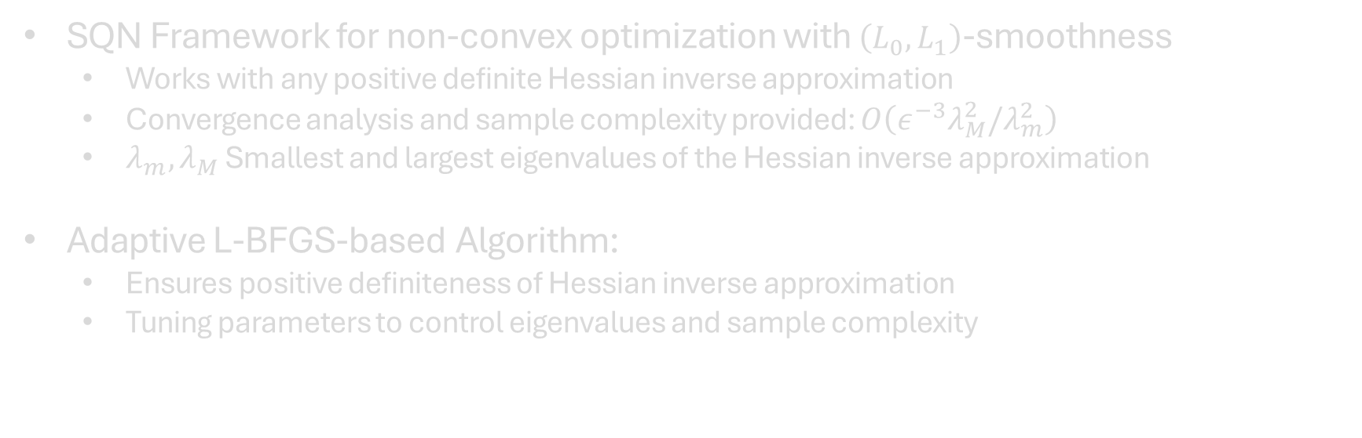
Our Contributions: Overview
SQN Framework for non-convex optimization with $\left(L_{0},L_{1}\right)$-smoothness
Works with any positive definite Hessian inverse approximation
Convergence analysis and sample complexity provided: $O\left(ε^{−3}λ_{M}^{2}/λ_{m}^{2}\right)$
$λ_{m},λ_{M}$ Smallest and largest eigenvalues of the Hessian inverse approximation
Adaptive L-BFGS-based Algorithm:
Ensures positive definiteness of Hessian inverse approximation
Tuning parameters to control eigenvalues and sample complexity
Advanced Optimization
13

Slide 14
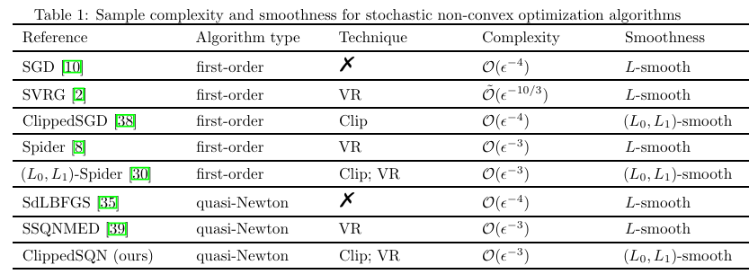
Comparison
Advanced Optimization
14

Slide 16
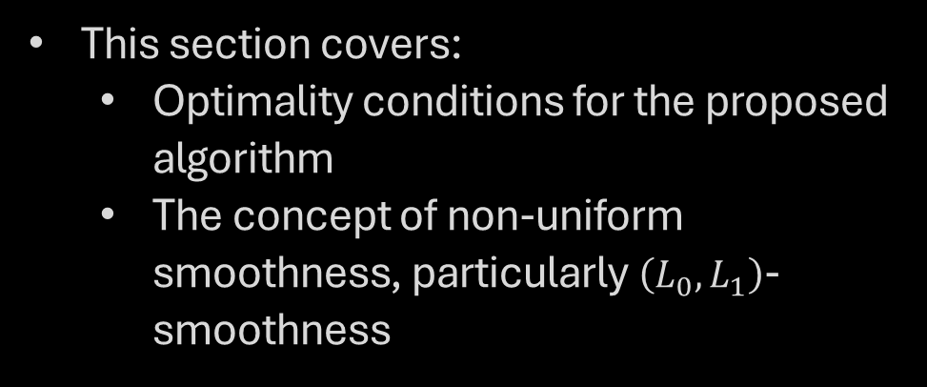
Overview of Preliminaries
This section covers:
Optimality conditions for the proposed algorithm
The concept of non-uniform smoothness, particularly $\left(L_{0},L_{1}\right)$-smoothness
Advanced Optimization
16

Slide 17

Optimality Condition
Goal: Find an ϵ-approximate first-order stationary solution
Why: Exact global minimum is NP-hard for general stochastic non-convex problems
Definition 2.1:
$\tilde{x}$is an ϵ-approximate first-order stationary solution if:
$$E\left[\left|\left|∇F\left(\tilde{x}\right)\right|\right|\right]≤ε$$
$ε$ > 0
Advanced Optimization
17

Slide 18

$\left(L_{0},L_{1}\right)$-Smoothness
introduces non-uniformity in smoothness
Definition 2.2:
For differentiable function $F:R^{d}→R$ F is $\left(L_{0},L_{1}\right)$-Smooth if
$$\left|\left|∇F\left(x\right)−∇F\left(y\right)\right|\right|≤\left(L_{0}+L_{1}\left|\left|∇F\left(x\right)\right|\right|\right)\left|\left|x−y\right|\right|$$
$L_{0}>0$
$L_{1}≥0$
Generalizes traditional Lipschitz-gradient condition:
For Lipschitz gradients $L_{1}=0$
Advanced Optimization
18

Slide 20
Overview of the Clipped SQN
Goal:
Present a method for fast convergence and low sample complexity in stochastic non-convex optimization.
Key Idea:
Combines the speed of quasi-Newton methods with clipping techniques for non-uniformly smooth functions.
Advanced Optimization
20

Slide 21

Algorithm 1
Inputs:
x0: Initial point
H0​: Positive definite Hessian inverse approximation
∣S1∣, ∣S2∣: Batch sizes
K, r: Integers for iteration count and sampling frequency
$\left\{η_{k}\right\}$: Stepsizes
Steps:
Iteration: For k=0,1,…,K−1
Sample Selection:
If k mod r = 0, draw samples S1​ and compute $v_{k}=∇l\left(x_{k};S_{1}\right)$
Otherwise, draw samples S2​, compute gradient differences, and update vk​
Stepsize Calculation: Compute ηk​ using equation (4)
Hessian Approximation: Generate Hk​ and calculate $H_{k}v_{k}$​ using Algorithm 2
Update: $x_{k+1}=x_{k}−η_{k}H_{k}v_{k}$
Output: x~K​ sampled uniformly from the iterates ${\left\{x_{k}\right\}}_{k=0}^{K−1}$​
Advanced Optimization
21

Slide 22
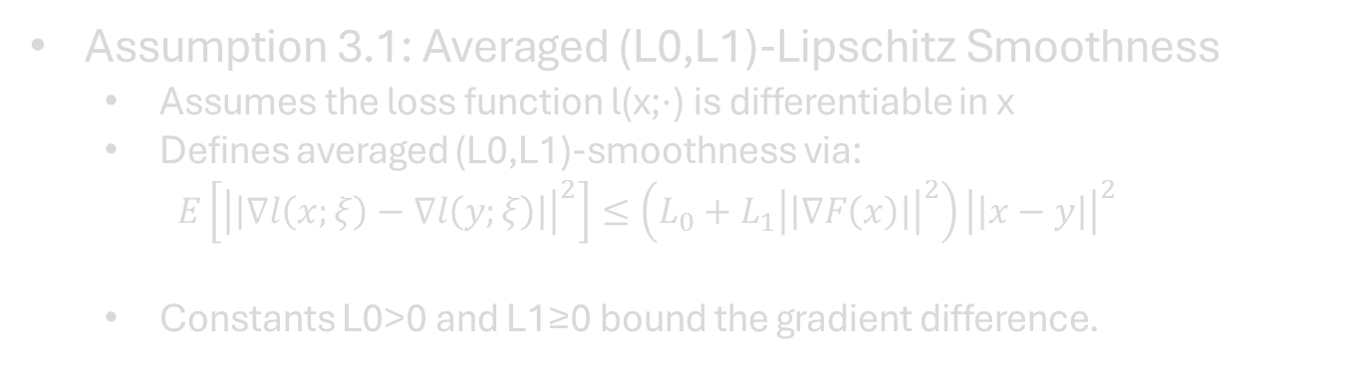
Assumptions for the Clipped SQN Method
Assumption 3.1: Averaged (L0,L1)-Lipschitz Smoothness
Assumes the loss function l(x;⋅) is differentiable in x
Defines averaged (L0,L1)-smoothness via:
$$E\left[{\left|\left|∇l\left(x;ξ\right)−∇l\left(y;ξ\right)\right|\right|}^{2}\right]≤\left(L_{0}+L_{1}{\left|\left|∇F\left(x\right)\right|\right|}^{2}\right){\left|\left|x−y\right|\right|}^{2}$$
Constants L0>0 and L1​≥0 bound the gradient difference.
Advanced Optimization
22

Slide 23

Assumptions Continued
Assumption 3.2: Unbiased Estimate and Bounded Variance
Assumes the gradient estimate $E\left[∇l\left(x;ξ\right)\right]=∇F\left(x\right)$
Bounded gradient variance: $\left[{\left|\left|∇l\left(x;ξ\right)\right|\right|}^{2}\right]≤σ^{2}$
Assumption 3.3: Hessian Inverse Approximation
Positive constants λm and λM​ such that:
λm ≤ Hk ≤ λ
Assumption 3.4: Dependency on Past Samples
Hk​ depends only on the samples ξk−1=(ξ0,…,ξk from previous iterations:
$$E\left[H_{k}v_{k} | ξ_{k−1},x_{k}\right]=H_{k}E\left[v_{k} | x_{k}\right]$$
Advanced Optimization
23

Slide 24
The Contribution of Algorithm 1
Combines Spider's first-order gradient tracking with quasi-Newton’s Hessian approximation for faster convergence.
Challenges:
Using Hk​vk​ introduces complexities in stepsize design and convergence analysis.
Advanced Optimization
24

Slide 25

Theorem 3.5: Sample Complexity Bound
Theorem 3.5:
Given Assumptions 3.3 and 3.4, the method achieves an $O\left(ε^{−3}λ_{M}^{2}/λ_{m}^{2}\right)$ sample complexity.
For any $0<β≤\frac{λ_{m}}{1+λ_{M}}$ the for achieving ϵ-approximate first-order stationary solutions we have:
$$E\left[\left|\left|∇F\left(\tilde{x_{K}}\right)\right|\right|\right]=O\left(\left(1+β\right)ε\right)$$
The number of iterations K is given by:
$$K=\left\lceil \frac{2L_{0}λ_{M}^{2}Δ_{0}}{h_{1}^{β}{\left(c\right)}^{2}ε^{2}}\right\rceil$$
Advanced Optimization
25

Slide 26
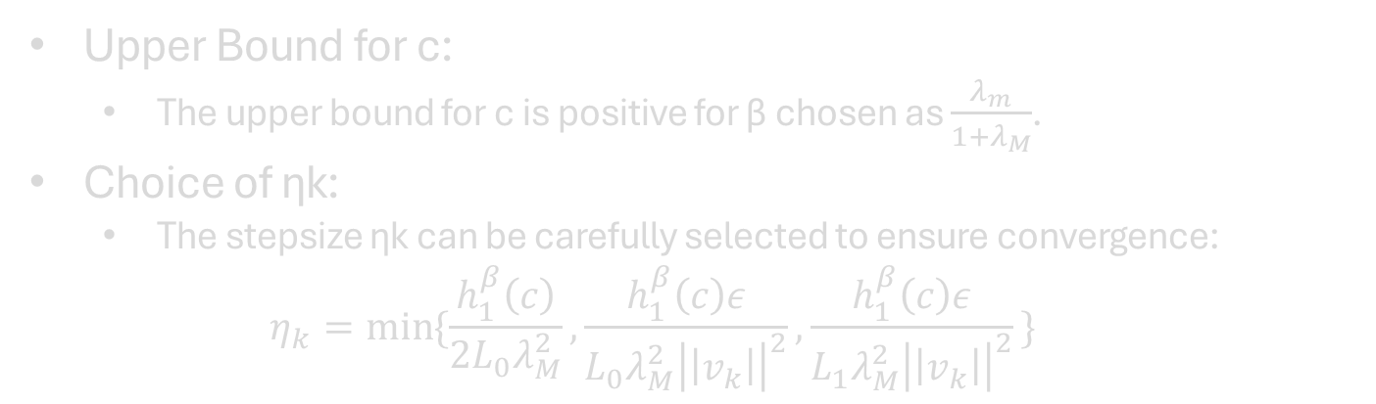
Remark 3.6: Clarifications on Parameters
Upper Bound for c:
The upper bound for c is positive for β chosen as $\frac{λ_{m}}{1+λ_{M}}$.
Choice of ηk​:
The stepsize ηk​ can be carefully selected to ensure convergence:
$$η_{k}=\min{\{\frac{h_{1}^{β}\left(c\right)}{2L_{0}λ_{M}^{2}},\frac{h_{1}^{β}\left(c\right)ε}{L_{0}λ_{M}^{2}{\left|\left|v_{k}\right|\right|}^{2}},\frac{h_{1}^{β}\left(c\right)ε}{L_{1}λ_{M}^{2}{\left|\left|v_{k}\right|\right|}^{2}}\text{\}} }$$
Advanced Optimization
26

Slide 28
The Contribution of Algorithm 1
Goal:
Justify Assumptions 3.3 and 3.4 by presenting an approach to generating Hk​ that meets these assumptions.
Focus:
Propose a method that allows control over the bounds of λm​ and λM​, which is crucial for ensuring fast convergence and low sample complexity as shown in Theorem 3.5.
Advanced Optimization
28

Slide 29
Stochastic Adaptive L-BFGS Method
The stochastic adaptive BFGS method:
computationally expensive
O(d^2) for calculating the Hessian inverse.
The stochastic adaptive L-BFGS method:
Introduced as a more efficient alternative.
Advanced Optimization
29

Slide 30
Key Points
Memory usage:
Stores a fixed number of vectors instead of the full Hessian matrix.
Memory size:
Is controlled by the parameter p
stores two sequences of vectors {sj} and {yj}.
Computational cost:
Reduces the cost to O(pd),
Making it more scalable for large problems.
Advanced Optimization
30

Slide 31
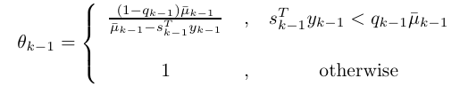



Equations
The initial Hessian approximation $H_{k,0}$:
$$H_{k,0}=c_{k}^{−1}I, c_{k}=\max\left\{δ,\frac{w_{k−1}^{T}y_{k−1}}{s_{k−1}^{T}y_{k−1}}\right\}$$
The definition of ${\overline{y}}_{k−1}:$
$${\overline{y}}_{k−1}=w_{k−1}\left(θ_{k−1}y_{k−1}+\left(1−θ_{k−1}\right)H_{k−1}^{0}s_{k−1}\right)$$
The update for Hk,i​ for any i:
$$H_{k,i}=\left(I−ρ_{j}s_{j}y_{j}^{T}\right)H_{k,i−1}\left(I−ρ_{j}y_{j}s_{j}^{T}\right)+ρ_{j}s_{j}s_{j}^{T}$$
Where $ρ_{j}={\left(s_{j}^{T}y_{j}\right)}^{−1}$
Advanced Optimization
31

Slide 32

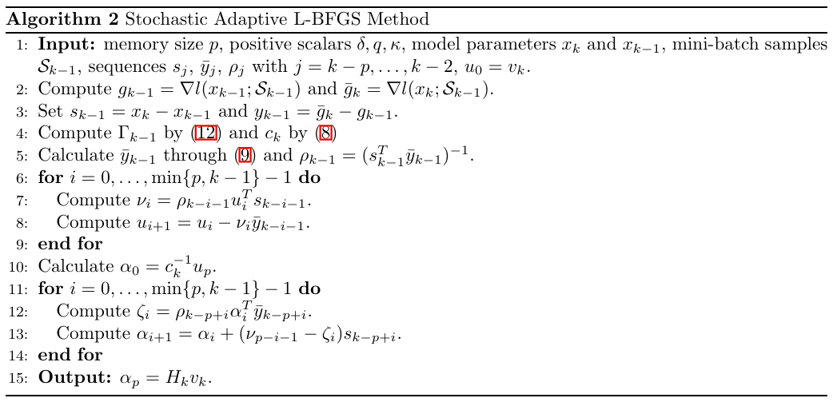
Algorithm for Stochastic Adaptive L-BFGS
Advanced Optimization
32

Slide 33

Assumption for Non-uniform Smoothness
Assumption 4.3:
Introduces a smoothness condition on the loss function, specifying that the squared norm of the difference of gradients can be bounded by a function of the distance between x and y.
$${\left|\left|∇l\left(x;ξ\right)−∇l\left(y;ξ\right)\right|\right|}^{2}≤\left(γ_{0}+γ_{1}\left|\left|∇l\left(x;ξ\right)\right|\right|\right){\left|\left|x−y\right|\right|}^{2}$$
Deduction of Assumption 3.1:
$$E\left[{\left|\left|∇l\left(x;ξ\right)−∇l\left(y;ξ\right)\right|\right|}^{2}\right]≤\left(\sqrt{2{(γ}_{0}^{2}+γ_{1}^{2}σ^{2})}+γ_{1}^{.}2^{1/2}\right){\left|\left|x−y\right|\right|}^{2}$$
Advanced Optimization
33

Slide 34


Theorems for $λ_{M} , λ_{m}$
Theorem 4.5:
$$λ_{m}={\left(δ+\frac{κ^{2}}{q_{.}γ_{0}^{4}}+(\frac{1}{δ}+\frac{δγ_{0}+κ^{2}}{γ_{0}^{3}}+\frac{p+2qγ_{0}^{4}}{2pγ_{0}^{.}})\right)}^{−1}$$
Theorem 4.6:
$$λ_{M}=\frac{1}{δγ_{0}^{2}κ^{2}q}\left(a^{p}−1\right)\frac{1}{a−1}$$
$$a=1+\frac{2}{δγ_{0}^{.}κ^{2}q}+{\left(\frac{1}{δγ_{0}^{.}κ^{2}q}\right)}^{2}$$
Advanced Optimization
34

Slide 36
Problem setup
Comparison with baseline methods:
First-order methods:
Mini-batch SGD
Spider
(L0,L1)-Spider
Quasi-Newton methods:
SdLBFGS
Two types of non-convex optimization problems:
Non-convex robust linear regression
Non-convex logistic regression
Advanced Optimization
37

Slide 37
Problem setup
Dataset generation:
The ith sample is denoted by (ai,bi) where:
ai∈R^d is a sparse vector with 10% nonzero elements.
bi​ is a binary label drawn from a specific rule: bi=sign(uiTai) where ui​ is a randomly drawn vector from [−1,1]d.
Dimension d=100.
Batch sizes and parameters:
∣S1∣=2000, ∣S2∣=100
Memory size p=5 for the quasi-Newton methods
Fixed batch size of 500 for mini-batch SGD and SdLBFGS
Advanced Optimization
38

Slide 38
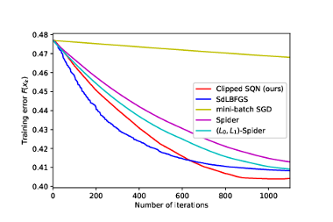
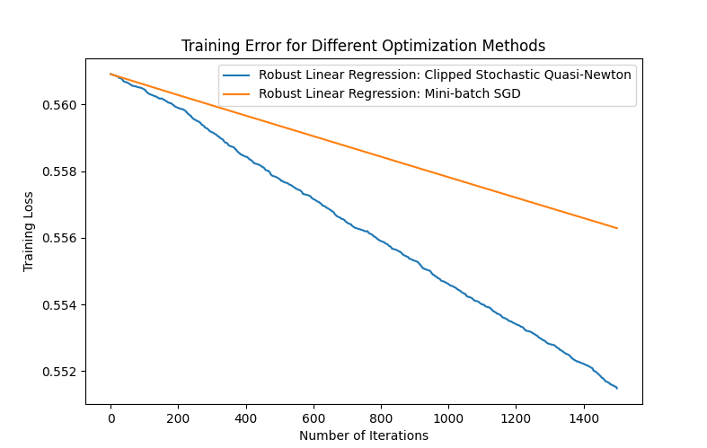
Non-convex Robust Linear Regression
Observation:
Quasi-Newton methods (SdLBFGS and Clipped SQN) demonstrate faster convergence compared to first-order methods.
The Clipped SQN method shows faster convergence in later iterations, though it lags slightly behind SdLBFGS initially.
Achieves a smaller training error at convergence.
Advanced Optimization
39

Slide 39
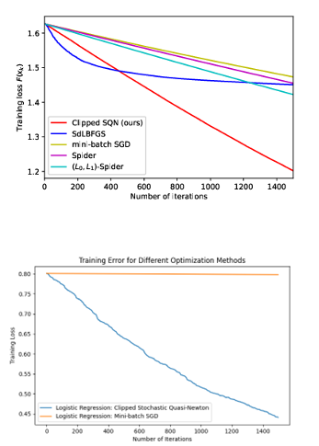
Non-convex Logistic Regression
Observation:
The Clipped SQN method outperforms all baseline algorithms in terms of both speed and accuracy.
It converges faster and achieves a lower final training error compared to SdLBFGS, mini-batch SGD, Spider, and (L0,L1)-Spider.
Advanced Optimization
40

Slide 40

THANK YOU

